Slide 1
Advanced Angular
Consuming HTTP Services
Lecture 7
By James(Jin) Wang
10/05/2019

Slide 2
Outline
Perform CRUD operations (Create, Read, Update and Delete)
Extract a reusable data service
Property handle different kinds of errors
Build applications with proper separation of concerns

Slide 3
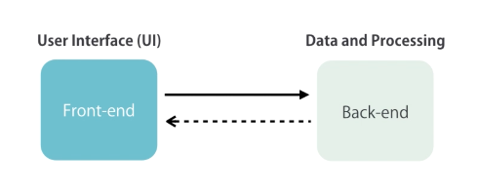
Perform CRUD operations

Slide 4
Perform CRUD operations
  Getting Data:
  http://jsonplaceholder.typicode.com/
  ng g c posts

Slide 5
Perform CRUD operations
  Getting Data:
  posts.component.ts: (add)
  constructor(http: HttpClient) {
  http.get('http://jsonplaceholder.typicode.com/posts')
  .subscribe(response => { this.posts = response;
  });
  }

Slide 6
Perform CRUD operations
  Getting Data:
  posts.component.html: (add)
  <ul class="list-group">
  <li *ngFor="let post of posts" class="list-group-item">
  {{ post.title }}
  </li>
  </ul>

Slide 7
Perform CRUD operations
  Greating Data:
  posts.component.html: (add)
  <input (keyup.enter)="createPost(title)" #title
  type="text" class="form-control">

Slide 8
Perform CRUD operations
  Greating Data:
  posts.component.ts: (add)
  createPost(input: HTMLInputElement) {
  let post = { title: input.value };
  input.value = '';
  this.http.post(this.url, JSON.stringify(post))
  .subscribe(response => {
  post['id'] = response.id;
  this.posts.splice(0, 0, post);
  // console.log(response);
  });
  }

Slide 9
Perform CRUD operations
  Updating Data:
  posts.component.html: (add)
  <button class="btn btn-default btn-sm"
  (click)="updatePost(post)">Update</button>
  posts.component.ts: (add)
  updatePost(post) {
  this.http.patch(this.url + '/' + post.id, JSON.stringify({ isRead: true }))
  .subscribe(response => {
  console.log(response);
  });
  }

Slide 10
Perform CRUD operations
  Deleting Data:
  posts.component.html: (add)
  <button class="btn btn-warning btn-sm"
  (click)="deletePost(post)">Delete</button>
  posts.component.ts: (add)
  deletePost(post) {
  this.http.delete(this.url + '/' + post.id)
  .subscribe(response => {
  let index = this.posts.indexOf(post);
  this.posts.splice(index, 1);
  });
  }

Slide 11
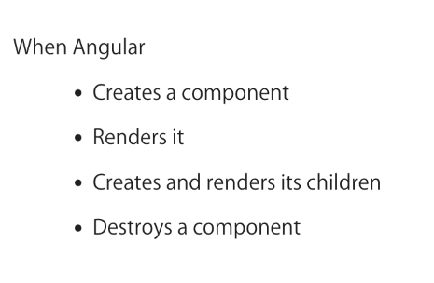
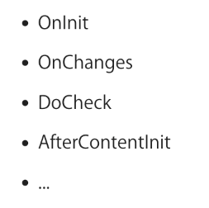
Perform CRUD operations
  Lifecycle Hooks:

Slide 12
Perform CRUD operations
  OnInit Interface:
  posts.component.ts:
  ngOnInit() {
  this.http.get(this.url)
  .subscribe(response => {
  this.posts = response;
  });
  }

Slide 13
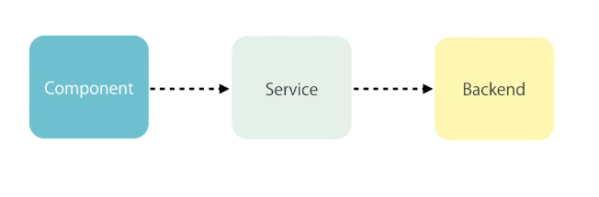
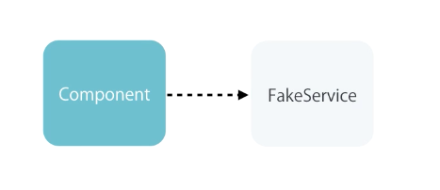
Reusable Data Service
  Separation of Concerns:

Slide 14
Reusable Data Service
  Extract a Service:
  ng g s post
  post.service.ts:
  getPosts()
  createPost(post)
  updatePost(post)
  deletePost(post)

Slide 15
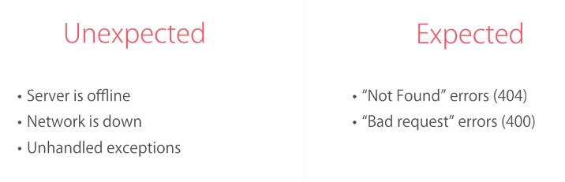
Handle Errors
  Handling Errors:

Slide 16
Handle Errors
  Handling Unexpected Errors:
  posts.component.ts:
  ngOnInit() {
  this.postService.getPosts()
  .subscribe(response => {
  this.posts = response;
  }, error => {
  alert('An unexpected error occurred.'); });
  }

Slide 17
Handle Errors
  Handling Expected Errors:
  posts.component.ts:
  deletePost(post) {
  (error: Response) => {
  if(error.status === 404) {
  alert('This post has already been deleted.');
  } else {
  alert('An unexpected error occurred.');
  console.log(error);
  }
  });
  }

Slide 18
Handle Errors
  Throw Application-specific Errors:
  post.service.ts:
  import { Observable } from 'rxjs';
  import 'rxjs/add/operator/catch’;
  deletePost(post) {
  return this.http.delete(this.url + '/' + post.id)
  .catch((error: Response) => {
  if(error.status === 404) {
  return Observable.throw(new NotFoundError());
  }
  return Observable.throw(new AppError(error));
  });
  }

Slide 19
Handle Errors
  Throw Application-specific Errors:
  app-error.ts:
  export class AppError {
  constructor(public originalError?: any) {}
  }
  not-found-error.ts:
  export class NotFoundError extends AppError {
  }
  posts.component.ts:
  deletePost(post) {
  if(error instanceof NotFoundError) {

Slide 20
Handle Errors
  Handling Bad Request Errors:
  post.service.ts:
  createPost(post) {
  return this.http.post(this.url, JSON.stringify(post)).catch((error: Response) => {
  if(error.status === 400) {
  return Observable.throw(new BadInput(error.json));
  }
  return Observable.throw(new AppError(error.json));
  });
  }

Slide 21
Handle Errors
  Handling Bad Request Errors:
  bad-input.ts:
  export class BadInput extends AppError {
  }
  posts.component.ts:
  createPost(input: HTMLInputElement) {
  (error: AppError) => {
  if(error instanceof BadInput) {

Slide 22
Handle Errors
  Global Error Handling:
  app-error-handler.ts:
  export class AppErrorHandler implements ErrorHandler {
  handleError(error) {
  alert('An unexpected error occurred.');
  console.log(error);
  }
  }

Slide 23
Handle Errors
  Global Error Handling:
  posts.component.ts: (update)
  ngOnInit() {
  createPost(input: HTMLInputElement) {
  updatePost(post) {
  deletePost(post) {

Slide 24
Handle Errors
  Extract a Reusable Error Handling Method:
  post.service.ts:
  private handleError(error: Response) {
  if(error.status === 400) {
  return Observable.throw(new BadInput(error.json));
  }
  if(error.status === 404) {
  return Observable.throw(new NotFoundError());
  }
  return Observable.throw(new AppError(error));
  }

Slide 25
Handle Errors
  Extract a Reusable Data Service:
  ng g s data
  data.service.ts:
  cut from post.service.ts
  post.service.ts:
  constructor(http: HttpClient) {
  super('http://jsonplaceholder.typicode.com/posts', http);
  }

Slide 26
Summary

